Slide 1
Cascading Style Sheets

Slide 2
Learning Outcomes
After completing this lesson, you should be able to
Explain what Cascading Style Sheet (CSS) is
Add CSS to HTML document in different ways
Explain Basic CSS concepts
Add Text related styles such as font and color

Slide 3

Cascading Style Sheets (CSS)
is the W3C standard for defining the presentation of documents written in HTML

Slide 4
How Stylesheets Work
Start with a document that has been marked up in HTML
Write style rules for how you ’ d like certain elements to look
Attach the style rules to the document

Slide 5
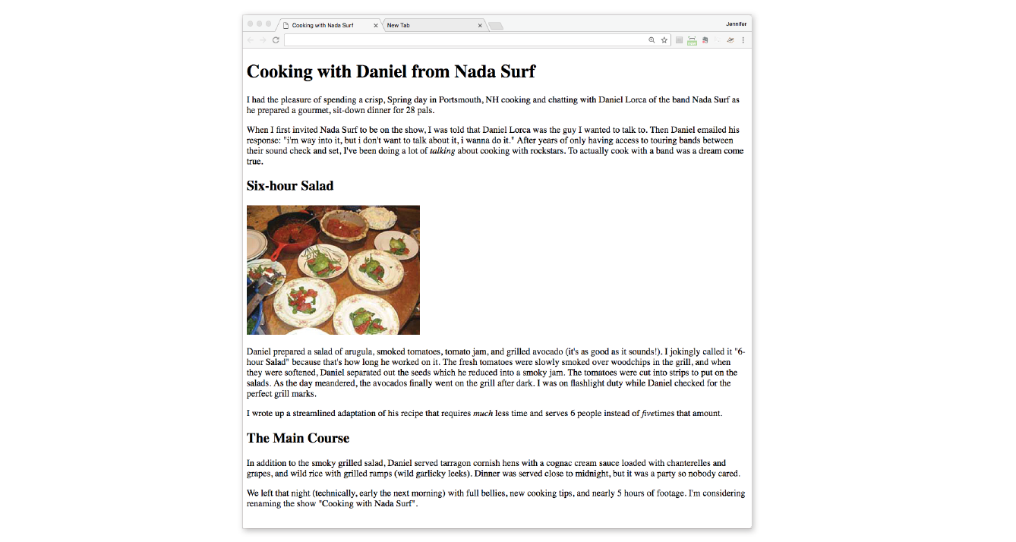
Marking Up the Document
Create the page shown in the right

Slide 6
Writing CSS Rules
A stylesheet is made up of one or more style instructions (called style rules) that describe how an element or group of elements should be displayed
Example Rules
h1 {
color: green;
}
p {
font-size: large;
font-family: sans-serif;
}

Slide 7
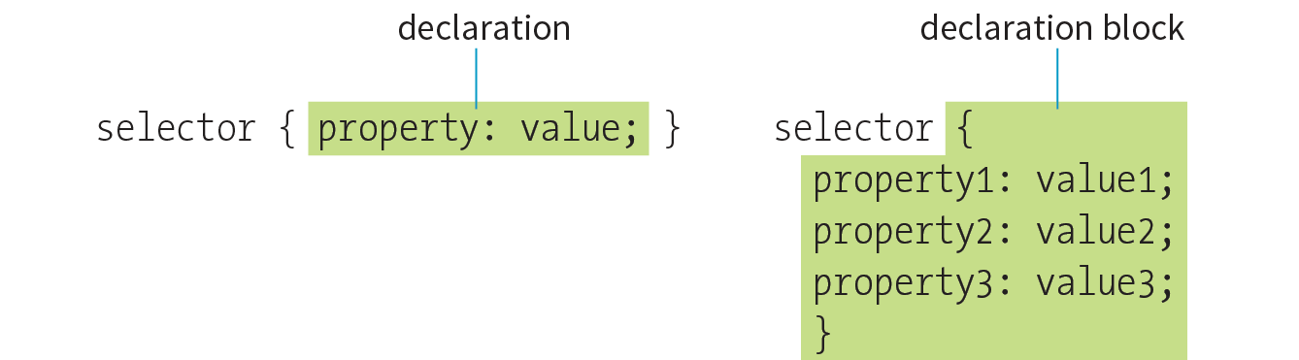
Writing CSS Rules
CSS Rule Syntax

Slide 8
Writing CSS Rules
The selector identifies the element or elements to be affected

Slide 9
Writing CSS Rules
The declaration provides the rendering instructions

Slide 10
Selectors
Element type selector | Universal selector (*)
Grouped selectors | Pseudo-class selectors
Descendent selectors | Pseudo-element selectors
ID and class selectors | Attribute selectors
Child, next-sibling, and following-sibling selectors

Slide 11
Selectors
h1 and p are element selectors
h1 {
color: green;
}
p {
font-size: large;
font-family: sans-serif;
}

Slide 12
Declarations
The declaration is made up of a property/value pair
Each declaration must end with a semicolon to keep it separate from the following declaration
h1 {
color: green;
}
p {
font-size: large;
font-family: sans-serif;
}

Slide 13
Exercise
In the html document you have created, insert the following code in the <head></head> element
<style>
h1 {
color: green;
}
p {
font-size: large;
font-family: sans-serif;
}
</style>

Slide 14
Grouped selectors
You can apply same style rule to multiple elements
p, ul, td, th { color: navy; }

Slide 15
Descendant Selectors
A descendant selector targets elements that are contained within (and therefore are descendants of) another element
Descendant selectors are indicated in a list separated by a character space
The following example targets emphasized text (em) elements, but only when they appear in list items (li)
li em {
color: olive;
}

Slide 16
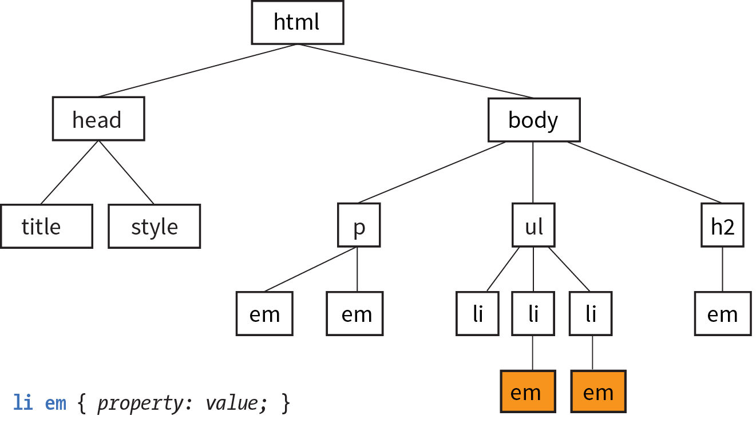
Descendant Selectors

Slide 17
Child selector
A child selector is similar to a descendant selector, but it targets only the direct children of a given element
They are indicated with the greater-than symbol (>)
The following rule affects emphasized text, but only when it is directly contained in a p element
An em element inside a link (a) within the paragraph would not be affected
p > em {font-weight: bold;}

Slide 18
Next-sibling selector
Targets an element that comes directly after another element with the same parent
It is indicated with a plus (+) sign
The following rule gives special treatment to paragraphs that follow an h1
h1 + p {
font-style: italic;
}

Slide 19
ID Selectors
id attribute gives an element a unique identifying name (its id reference)
ID selectors allow you to target elements by their id values
The symbol that identifies ID selectors is the octothorpe (#), also known as a hash or pound symbol
<li id="sleestak">Sleestak T-shirt</li>
li#sleestak { color: olive; }
#sleestak { color: olive; }

Slide 20
Class Selectors
The class identifier is used to classify elements into a conceptual group
Unlike the id attribute, multiple elements may share a class name
An element may belong to more than one class
You can target elements belonging to the same class with a class selector
Class names are indicated with a period (.) at the beginning of the selector

Slide 21
Class Selectors
For example, to select all paragraphs with class="special", use the following selector
p.special {
color: orange;
}

Slide 22
Class Selectors
To apply a property to all elements of the same class, omit the element name in the selector
.special {
color: orange;
}

Slide 23
The Universal Selector
The universal element selector (*) matches any element
The following style rule puts a 1-pixel gray border around every element in the document
* {
border: 1px solid gray;
}

Slide 24
Exercise
Change the color of h1
Add a new rule that makes the h2 elements orange
Add a 100-pixel left margin to paragraph (p) elements by using this declaration
margin-left: 100px;
Add a 100-pixel left margin to h2 elements

Slide 25
Exercise
Add an orange, 1-pixel border to the bottom of the h1 element by using this declaration
border-bottom: 1px solid orange;
Move the image to the right margin, and allow text to flow around it with the float property
img {
float: right;
margin: 0 10px;
}

Slide 26
Attaching the Styles to the Document
There are three ways that style information can be applied to an HTML document
Embedded stylesheets
Inline styles
External stylesheets

Slide 27
Embedded style sheets
The stylesheet is placed in a document via the style element
The rules apply only to the document where the style is embedded
<head>
<title>Required document title here</title>
<style>
/* style rules go here */
</style>
</head>

Slide 28
Inline styles
You can apply properties and values to a single element by using the style attribute in the element itself
To add multiple properties, just separate them with semicolons
<h1 style="color: red">Introduction</h1>
<h1 style="color: red; margin-top: 2em">Introduction</h1>

Slide 29
Inline styles
Inline styles should be avoided, unless it is absolutely necessary to override styles from an embedded or external style sheet
Inline styles are problematic in that they intersperse presentation information into the structural markup

Slide 30
External style sheets
A separate text-only document that contain style rules
It must be named with the .css suffix
This is the most preferred method for attaching stylesheets to content

Slide 31
Exercise
Write an inline style that makes the second h2 gray in the previous html document
<h2 style="color: gray">The Main Course</h2>

Slide 32
Exercise
Create a file named styles.css and take all the style rules from the html document to the styles.css file
Attach the styles to the html by including the following element in the <head></head> element
<link rel="stylesheet" href="styles.css">

Slide 33
Main Concepts
Inheritance
Parents and children
Priority
Document structure
The Box Model
Cascade
Specificity
Rule order
CSS Units

Slide 34
Inheritance
Styled HTML elements pass down certain style properties to the elements they contain
Inheritance provides a mechanism for styling elements that don’t have any explicit styles rules of their own

Slide 35
Exercise
In the previous html document add emphasis to the first word of the second paragraph using <em></em> element
Change the font size of the paragraph and check if the font size of the continent inside <em></em> element also changes or not
Check the inherited style rules using Chrome DevTools

Slide 36
Document structure
HTML documents have an implicit structure, or hierarchy

Slide 37
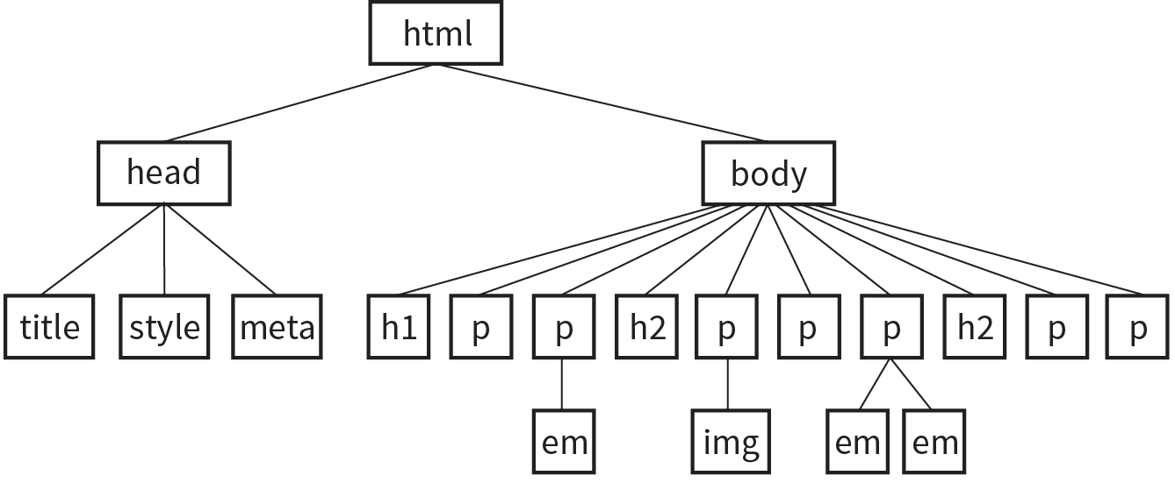
Document structure

Slide 38
Parent/Child Relationship
All the elements contained within a given element are said to be its descendants
For example, the h1, h2, p, em, and img elements in the document tree shown in the previous slide are all descendants of the body element

Slide 39
Parent/Child Relationship
An element that is directly contained within another element (with no intervening hierarchical levels) is said to be the child of that element
Conversely, the containing element is the parent
For example,
the em element is the child of the p element, and the p element is its parent

Slide 40
Parent/Child Relationship
All of the elements higher than a particular element in the hierarchy are its ancestors
Two elements with the same parent are siblings

Slide 41
Property Inheritance
In general, properties related to the styling of text—font size, color, style, and the like—are inherited by child elements
Properties such as borders, margins, backgrounds, and so on that affect the boxed area around the element tend not to be passed down

Slide 42
Exercise
If you want to apply similar color to all texts in your document to which element should you add the color style rule in your stylesheet?
Check your answer by adding the style rule to make all your document color to blue

Slide 43
Conflicting Styles: The Cascade
CSS allows you to apply several style sheets to the same document, which means there are bound to be conflicts
The “cascade” refers to what happens when several sources of style information compete for control of the elements on a page
CSS uses a hierarchical system that assigns different weights to the various sources of style information to handle conflicting rules
Weight is considered based on the priority of the style rule source, the specificity of the selector, and rule order

Slide 44
Style Rule Hierarchy
Any style rule marked !important by the reader (user)
Individual users can apply their own styles
Any style rule marked !important by the author
Stylesheets written by the author
Stylesheets created by the reader (user)
Browser’s default style rules (“user agent stylesheet”)

Slide 45
Assigning Importance
If you want a rule not to be overridden by a subsequent conflicting rule, include the !important indicator just after the property value and before the semicolon for that rule
p {
color: blue !important;
}

Slide 46
Specificity
It is possible for conflicts to arise in which an element is getting style instructions from more than one rule
When two rules in a style sheet conflict, the type of selector is used to determine the winner
Specificity refers to the fact that more specific selectors have more weight when it comes to handling style rule conflicts

Slide 47
Rule order
Within a style sheet, if there are conflicts within style rules of identical weight, whichever one comes last in the list “wins.”
p {
color: red;
}
p {
color: blue;
}
p {
color: green;
}

Slide 48
The Box Model
Browsers see every element on the page (both block and inline) as being contained in a little rectangular box
You can apply properties such as borders, margins, padding, and backgrounds to these boxes

Slide 49
Exercise
Use Chrome DevTools to check the rectangular box around each element

Slide 50
CSS Units
CSS3 provides a variety of units of measurement
They fall into two broad categories: absolute and relative

Slide 51
CSS Units
Absolute units have predefined meanings or real-world equivalents
With the exception of pixels, they are not appropriate for web pages that appear on screens
Relative units are based on the size of something else, such as the default text size or the size of the parent element
Child elements do not inherit the relative values of their parent, but rather the resulting calculated value

Slide 52
Absolute Units
px
pixel, defined as equal to 1/96 of an inch in CSS3
in
inches
mm
millimeters

Slide 53
Relative units
em
a unit of measurement equal to the current font size
ex
x-height, approximately the height of a lowercase “x” in the font
rem
root em, equal to the em size of the root element (html)

Slide 54
Relative units
ch
zero width, equal to the width of a zero (0) in the current font and size
vw
viewport width unit, equal to 1/100 of the current viewport (browser window) width
vh
viewport height unit, equal to 1/100 of the current viewport height

Slide 55
Relative units
vmin
viewport minimum unit, equal to the value of vw or vh, whichever is smaller
vmax
viewport maximum unit, equal to the value of vw or vh, whichever is larger

Slide 56
CSS Units: Percentages
Percentages are another common measurement value for web page elements
Percentages are calculated relative to another value, such as the value of a property applied to the current element or its parent or ancestor
When used for page layouts, percentage values ensure that page elements stay proportional

Slide 57
The rem unit
In modern browsers, the default root font size is 16 pixels; therefore, a rem is equivalent to a 16-pixel unit

Slide 58
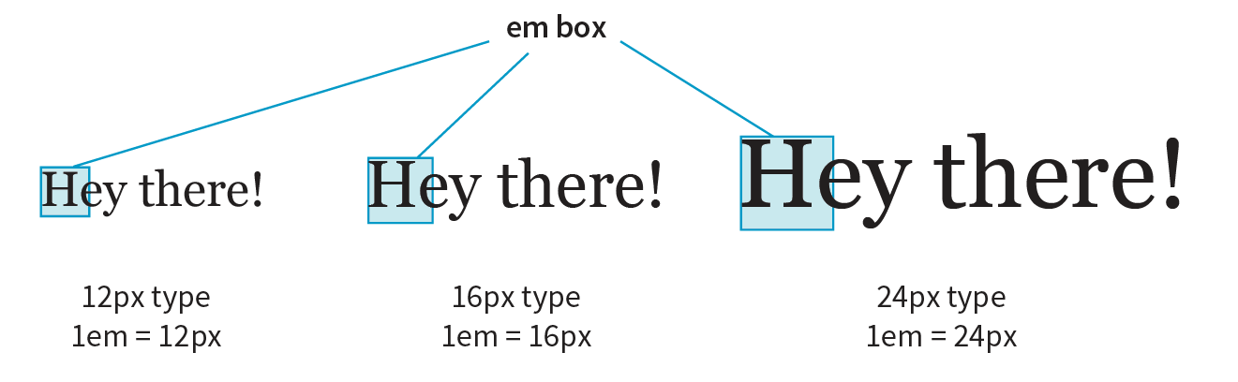
The em unit
For text with a font size of 16 pixels, an em measures 16 pixels; for 12-pixel text, an em equals 12 pixels

Slide 59
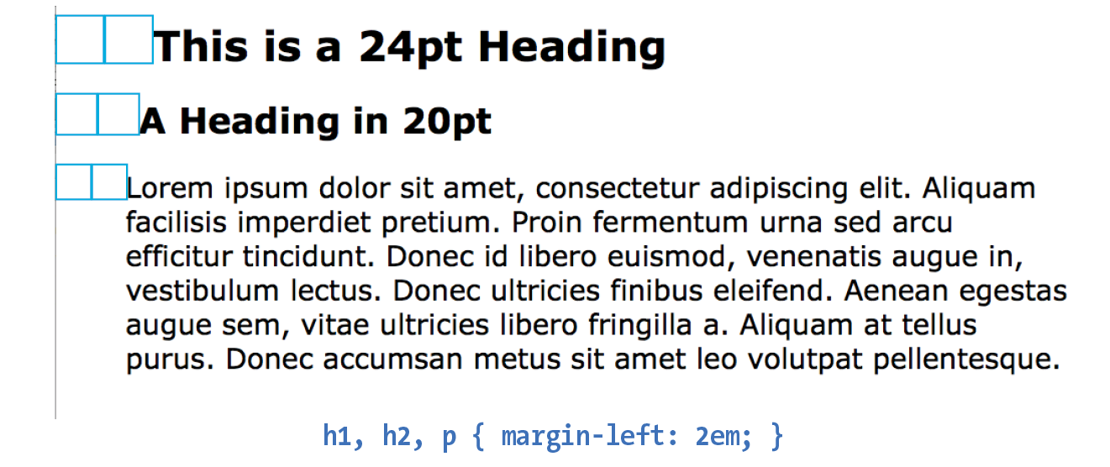
The em unit

Slide 60
Viewport percentage lengths (vw/vh)
The viewport width (vw) and viewport height (vh) units are relative to the size of the viewport (browser window)
A vw is equal to 1/100 the width of the viewport
A vh is equal to 1/100 the height of the viewport
Viewport-based units are useful for making images and text elements stay the full width or height of the viewport

Slide 61
Viewport percentage lengths (vw/vh)
header {
width: 100vw;
height: 100vh;
}
img {
width: 50vw;
height: 50vh;
}

Slide 62
Formating Text

Slide 63
Basic Font Properties
In CSS, fonts are specified using a set of font-related properties for typeface, size, weight, font style, and special characters
There are also shortcut properties that let you specify multiple font attributes in a single rule

Slide 64
Font Properties
font-family
font-size
font-weight
font-style
font-variant
font

Slide 65
Typeface (Font Family)
font-family
p { font-family: "Duru Sans", Verdana, sans-serif; }

Slide 66
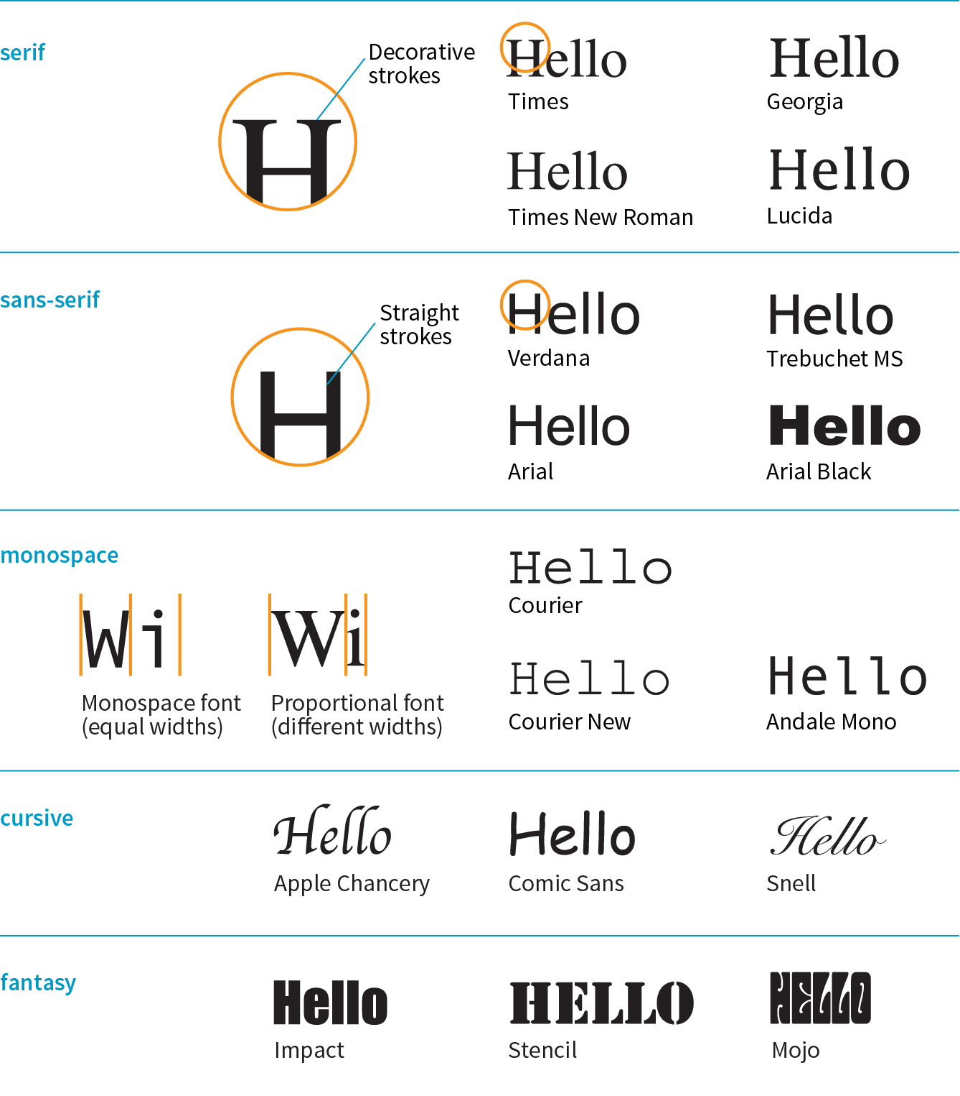
Generic font families

Slide 67
Generic font families
Serif
Examples: Times New Roman, Georgia
Serif typefaces have decorative slab-like appendages (serifs) on the ends of certain letter strokes

Slide 68
Generic font families
sans-serif
Examples: Arial, Verdana, Trebuchet MS, Helvetica
Sans-serif typefaces have straight letter strokes that do not end in serifs

Slide 69
Generic font families
monospace
Examples: Courier New
Monospace (also called constant width) typefaces, all characters take up the same amount of space on a line

Slide 70
Font stack strategies
The best practice for specifying fonts for web pages is to
start with your first choice,
provide some similar alternatives, and then
end with a generic font family
body {
font-family: Oswald, Univers, Tahoma, Geneva, sans-serif;
}

Slide 71
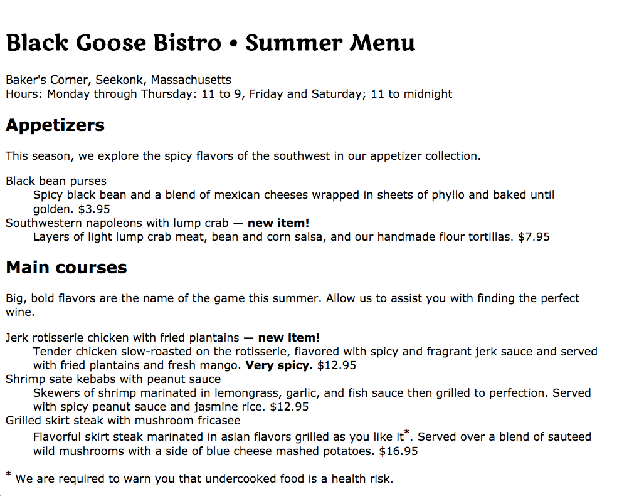
Exercise
Create HTML document inside menu.html file for the page shown

Slide 72
Exercise
Make main text of the HTML document you have created appear in Verdana or some other sans-serif font
body {
font-family: Verdana, sans-serif;
}

Slide 73
Exercise
Use display font called Marko One from Google Web Fonts (www.google.com/webfonts)
<head>
<meta charset="UTF-8">
<title>CSS Lab</title>
<link href="http://fonts.googleapis.com/css?family=Marko+One" rel="stylesheet">
<link href="css/styles.css" rel="stylesheet" >
</head>

Slide 74
Exercise
Write a rule that applies Marko One font to the h1 element
h1 {
font-family: "Marko One", Georgia, serif;
}

Slide 75
Specifying Font Size
font-size
Values: length unit | percentage | xx-small | x-small | small | medium | large | x-large | xx-large | smaller | larger
Default: medium
The preferred font-size values are em, rem, and %

Slide 76
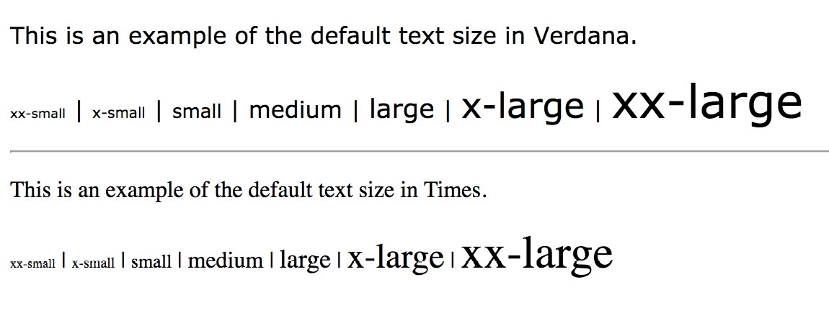
Specifying Font Size

Slide 77
Specifying Font Size
Percentage values
To maintain the browser’s default size, set the font-size of the root element to 100%
html {
font-size: 100%;
}

Slide 78
Specifying Font Size
Percentage values
In the following example, the h1 inherits the default 16px size from the html element, and applying the 150% value multiplies that inherited value, resulting in an h1 that is 24 pixels:
h1 {
font-size: 150%; /* 150% of 16 = 24 */
}

Slide 79
Exercise
Set the font-size of the body element to 100%
Set the main heading to be 24 pixels using em or percentage units
Make the h2s the same size as the body text

Slide 80
Font Weight (Boldness)
font-weight
Values: normal | bold | bolder | lighter | 100 | 200 | 300 | 400 | 500 | 600 | 700 | 800 | 900
Default: normal
An example is shown in the next slide

Slide 81
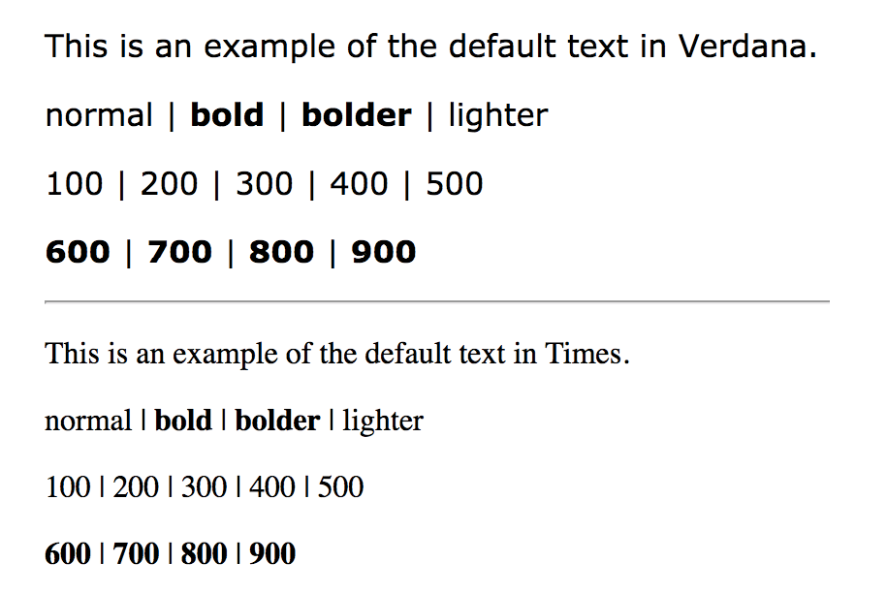

Slide 82
Font Style (Italics)
The font-style property affects the posture of the text—that is, whether the letter shapes are vertical (normal) or slanted (italic and oblique)
font-style
Values: normal | italic | oblique
Default: normal

Slide 83
Exercise
Make the definition terms bold and italic

Slide 84
The Shortcut font Property
font
Values: font-style font-weight font-variant font-stretch font-size/line-height font-family | caption | icon | menu | message-box | small-caption | status-bar
Default: depends on default value for each property listed

Slide 85
The Shortcut font Property
font
At minimum, the font property must include a font-size value and a font-family value, in that order
p {
font: 1em sans-serif;
}

Slide 86
The Shortcut font Property
font
At minimum, the font property must include a font-size value and a font-family value, in that order
p {
font: 1em sans-serif;
}

Slide 87
EXERCISE
Replace all the font properties we’ve specified for the h1 element with one declaration with the shorthand font property
h1 {
font: bold 1.5em "Marko One", Georgia, serif;
}

Slide 88
Changing Text Color
color
Values: color value (name or numeric)
Default: depends on the browser and user’s preferences

Slide 89
h1 {
color: gray;
}
h1 {
color: #666666;
}
h1 {
color: #666;
}
h1 {
color: rgb(102, 102, 102);
}
Changing Text Color
color

Slide 90
Text Line Adjustment
The line-height property defines the minimum distance from baseline to baseline in text
line-height
Values: number | length measurement | percentage | normal
Default: normal

Slide 91
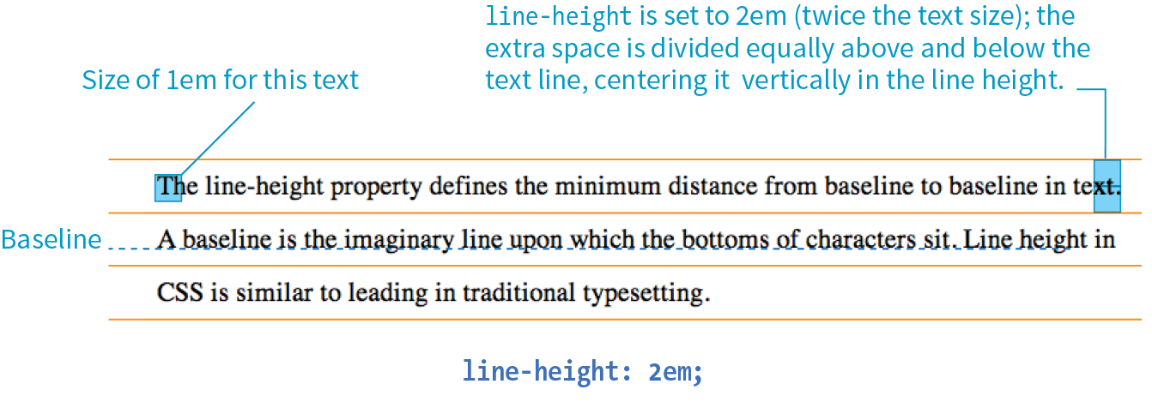
Text Line Adjustment

Slide 92
Text Line Adjustment
Example
p {
line-height: 2;
}
p {
line-height: 2em;
}
p {
line-height: 200%;
}

Slide 93
Indents
text-indent
Values: length measurement | percentage
Default: 0

Slide 94
Indents
p#1 {
text-indent: 2em;
}
p#2 {
text-indent: 25%;
}
p#3 {
text-indent: -35px;
}
Example
The effect is shown in the next slide

Slide 95
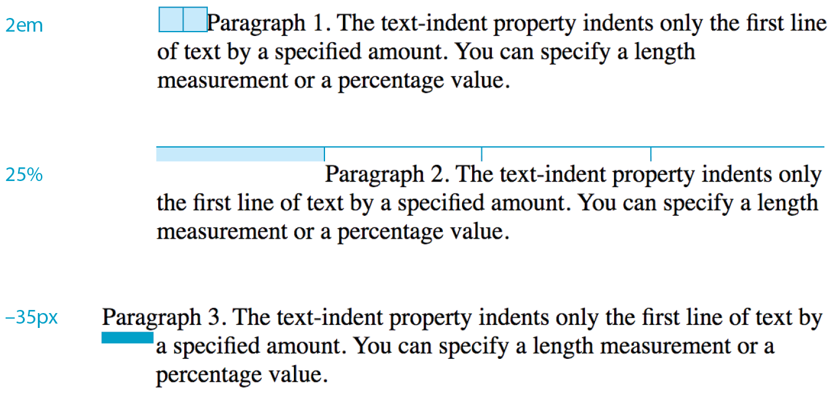

Slide 96
Horizontal Text Alignment
text-align
Values: left | right | center | justify | start | end
Default: start
An example is shown in the next slide

Slide 97
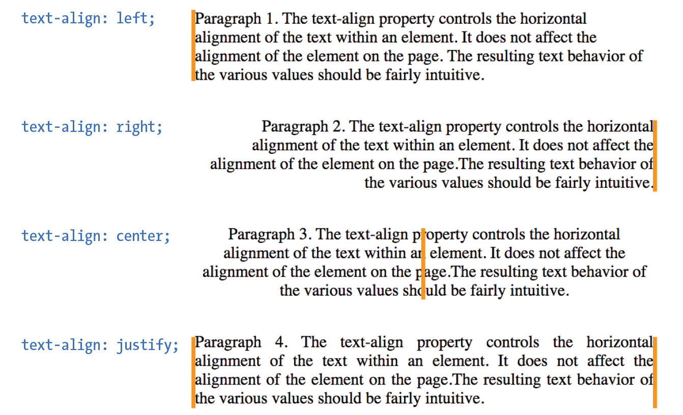

Slide 98
Text Decoration
text-decoration
Values: none | underline | overline | line-through | blink
Default: none

Slide 99
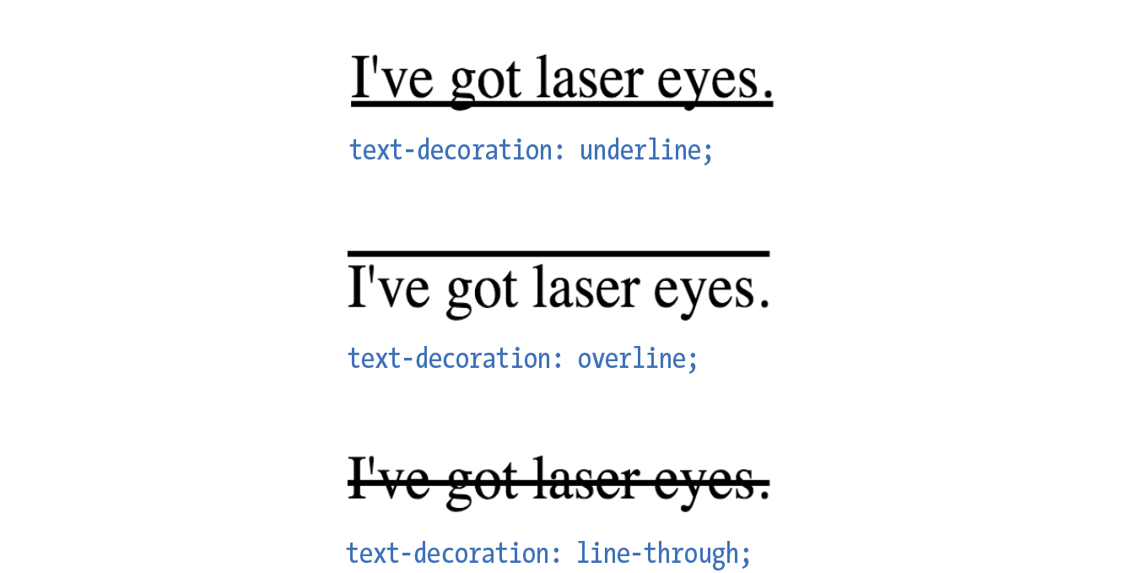
Text Decoration
Examples

Slide 100
Text Capitalization
text-transform
Values: none | capitalize | lowercase | uppercase | full-width
Default: none
Check next slide or example

Slide 101
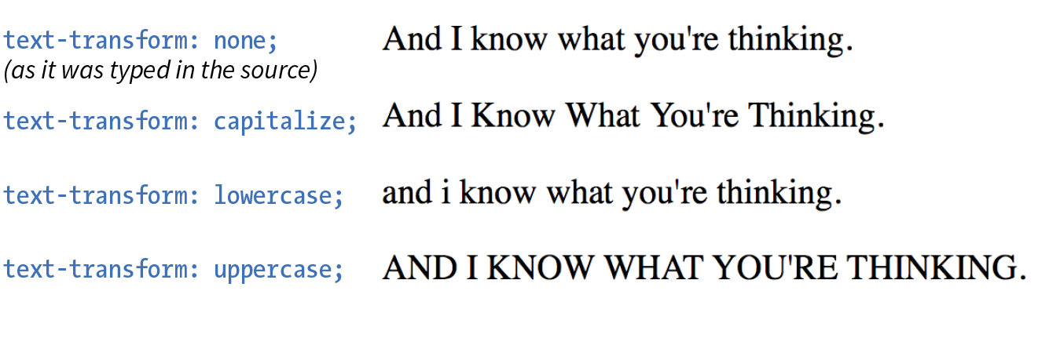
Text Capitalization
Examples

Slide 102
Letter Spacing
letter-spacing
Values: length measurement | normal
Default: normal

Slide 103
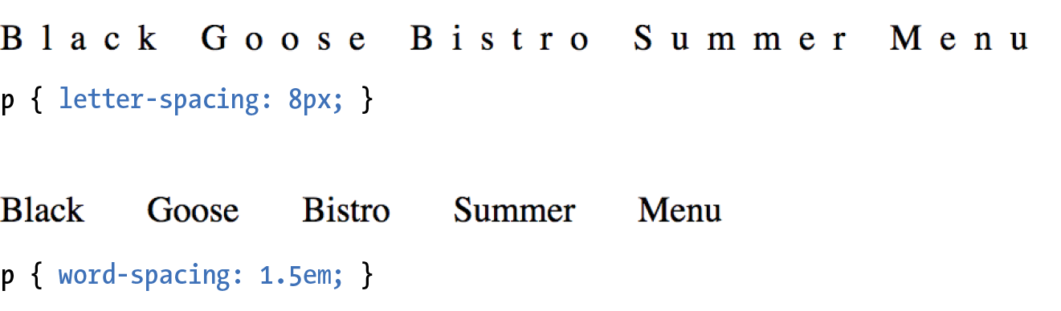
Letter Spacing
Examples

Slide 104
List Markers
list-style-type
Values: none | disc | circle | square | decimal | decimal-leading-zero | lower-alpha | upper-alpha | lower-latin | upper-latin | lower-roman | upper-roman | lower-greek
Default: disc

Slide 105
Numbering and Lettering Styles
Keyword | System
decimal | 1, 2, 3, 4, 5, ...
decimal-leading-zero | 01, 02, 03, 04, 05, ...
lower-alpha or lower-latin | a, b, c, d, ...
upper-alpha or upper-latin | A, B, C, D, ...
lower-roman | i, ii, iii, iv, v, ...
upper-roman | I, II, III, IV, V, ...
lower-greek | α, β, γ, δ, ε, ...

Slide 106
List Item Display Role
Any element can perform like a list item by setting its display property to list-item
p.lettered {
display: list-item;
list-style-type: upper-alpha;
}

Slide 107
List Marker Position
list-style-position
Values: inside | outside | hanging
Default: outside

Slide 108
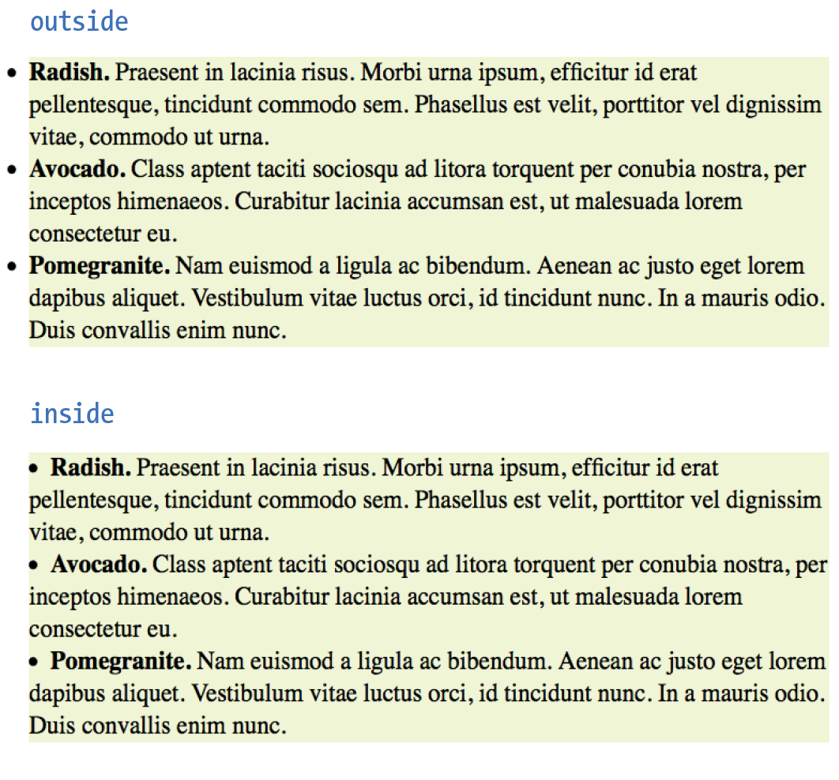
List Marker Position

Slide 109
Custom Bullets
list-style-image
Values: url(location) | none
Default: none

Slide 110
Custom Bullet
Example
ul {
list-style-type: disc;
list-style-image: url(/images/custom_bullet.gif);
list-style-position: outside;
}

